Slide 1
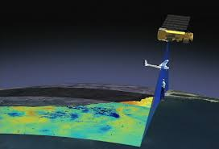
LESSON 1
Basics of Remote Sensing
Foundation

Slide 2

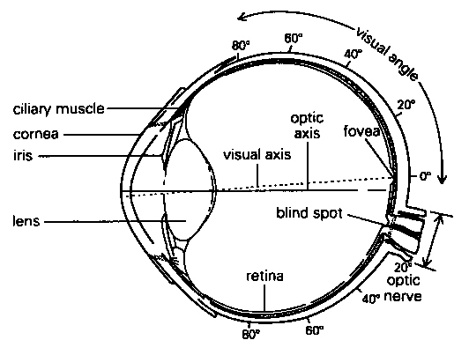

What is remote sensing ?
Remote – away from or at a distance
Sensing – detecting a property or characteristic
Process: Source of energy

Slide 3
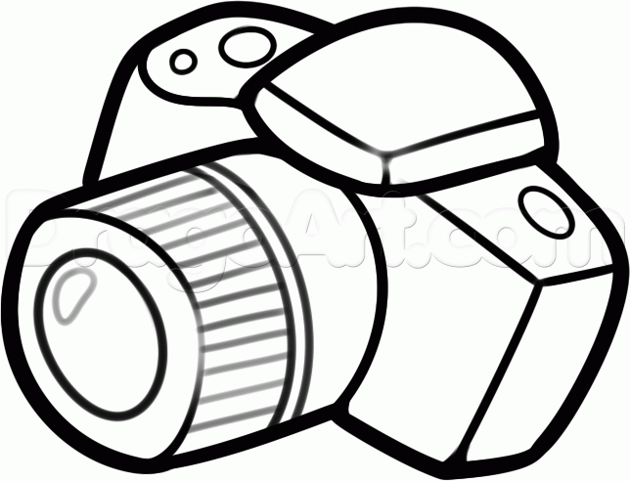
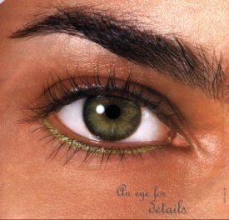
What is remote sensing ?
Remote – away from or at a distance
Sensing – detecting a property or characteristic
INTERPRETATION
House/Hut

Slide 4
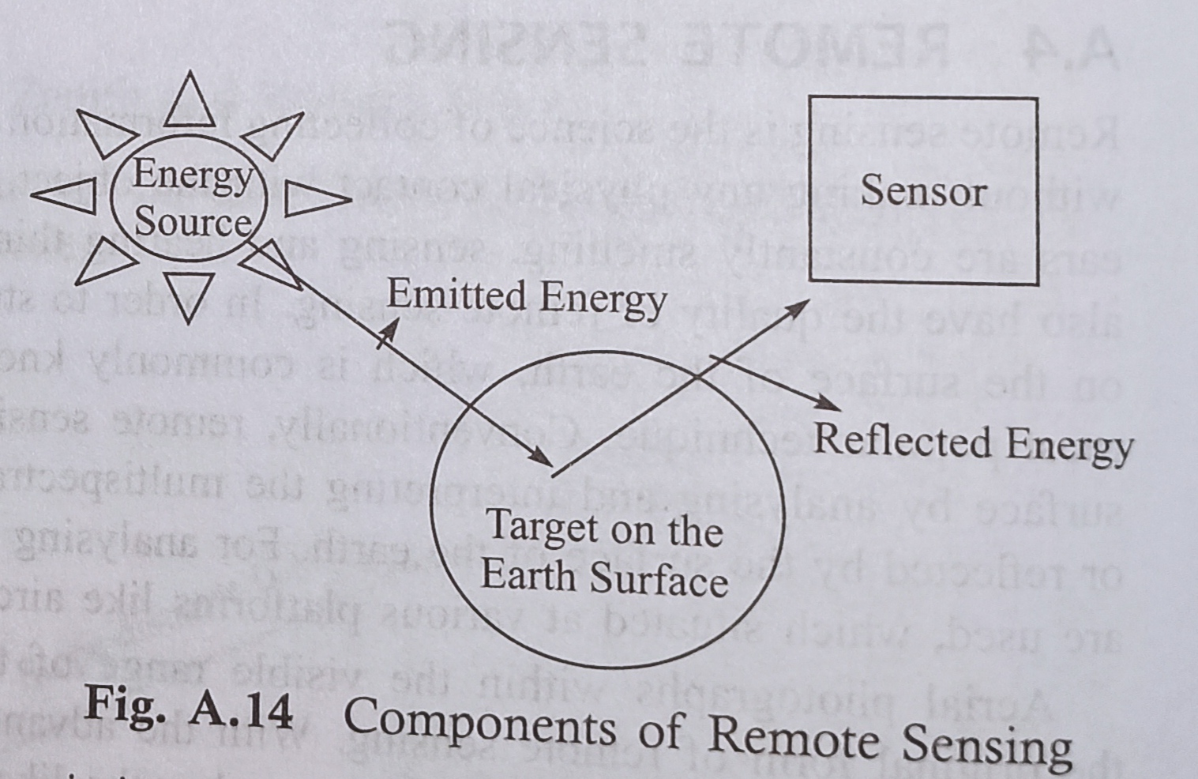
Remote sensing requirement:
Source of radiation
Object to be detected
Platform, Sensor and method of analysis

Slide 5
The term "remote sensing," first used in the United States in the 1950s by Ms.Evelyn Pruitt of the U.S. Office of Naval Research.
is now commonly used to describe the science—and art—of identifying, observing, and measuring an object without coming into direct contact with it..
“The art and science of obtaining information about an object without being in direct contact with the object” (Jensen 2000).

Slide 6

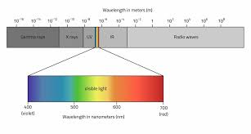
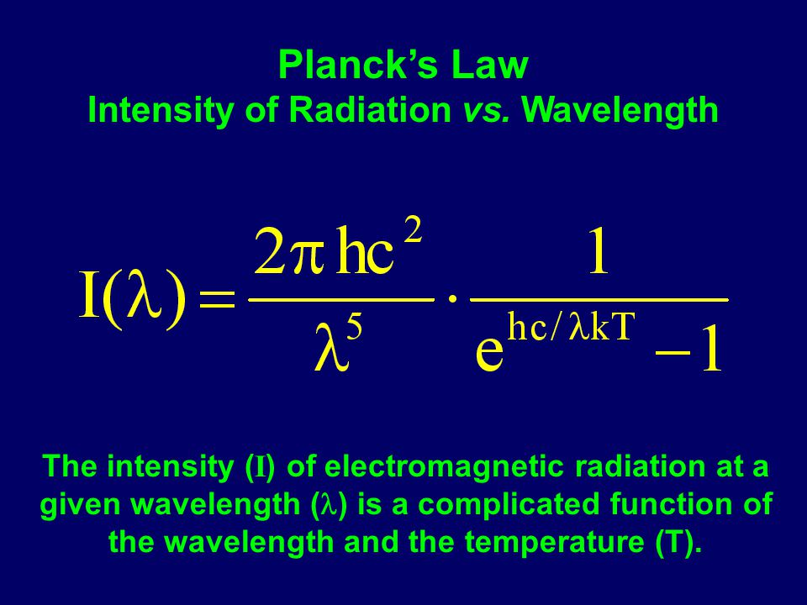
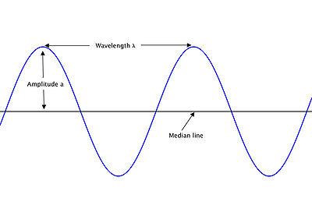
Planck’s Law Intensity of Radiation vs. Wavelength The intensity (I) of electromagnetic radiation at a given wavelength () is a complicated function of the wavelength and the temperature (T). h plank’s constant 6.626 x 10^-34 (J.s)
k Boltzmann’s constant 1.380 x 10^-23 (J.K^-1). c velocity of light 2.998 x 10^8 (m.s^-1)

Slide 7
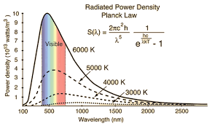
Power density is the amount of power (time rate of energy transfer) per unit volume.

Slide 8
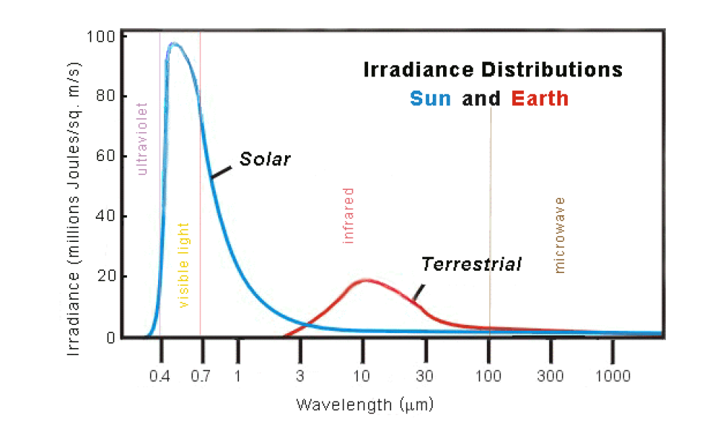
Solar irradiance ( Power of EM radiation incident per unit area on a surface.
Almost 90 percent of energy is in range of .28 to 4.96 micrometer)
About 43 percent radiation is in visible wavelength ( .4 to .7)
Maximum energy is 0.48 i.e green wave length

Slide 9
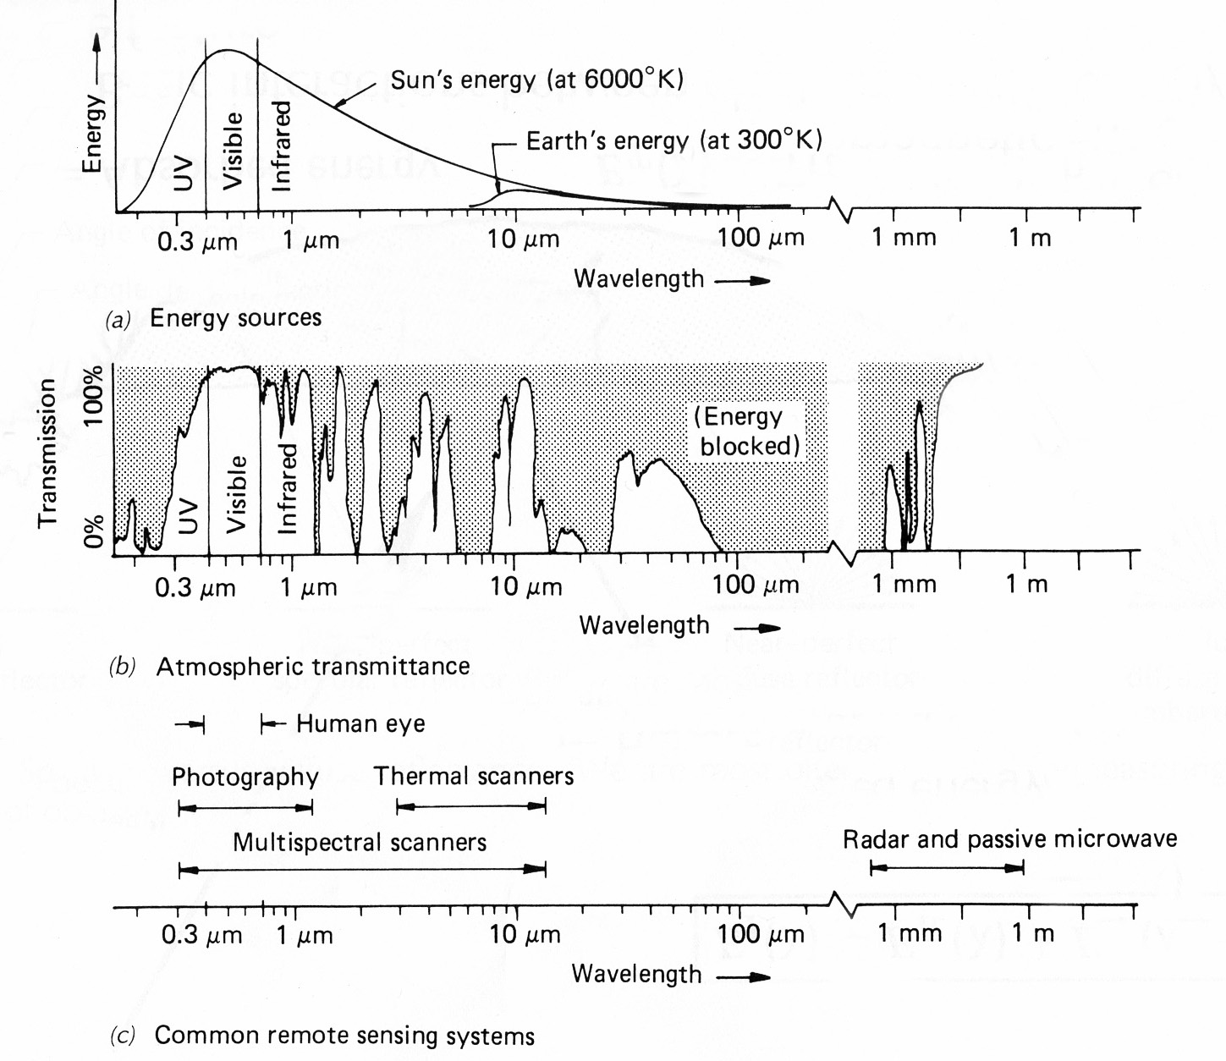
Spectral Characteristics of Energy Sources and Sensing Systems
IR
4 µm
11 µm

Slide 10
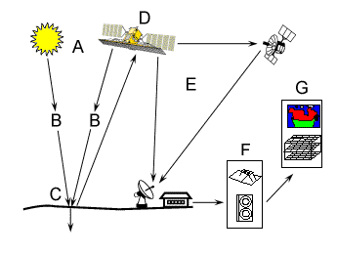
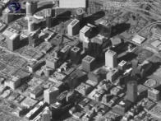
What are components of Remote Sensing
OR What are the processes in remote sensing
Energy Source or Illumination (A)
Radiation and the Atmosphere (B)
Interaction with the Target (C)
Recording of Energy by the Sensor (D)
Transmission, Reception, and Processing (E)
Interpretation and Analysis (F)
Application (G)
Requirement:
Source of energy - Sun
Object – Ground features
Sensor – camera etc
Data processing- covert data to a usable form
Image- Interpretation
Source: Canadian Centre for Remote Sensing

Slide 11
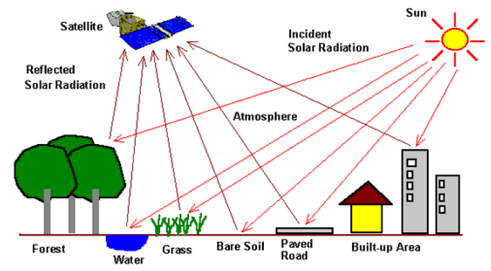
Remote Sensing
Definition of remote sensing
Remote sensing is the branch of science delivering information about objects through the analysis of data collected by spectral instruments that are not in physical contact with the objects of investigation.
The detection and recording instruments for this technology are known as remote sensors. The object being monitored is called target.

Slide 12
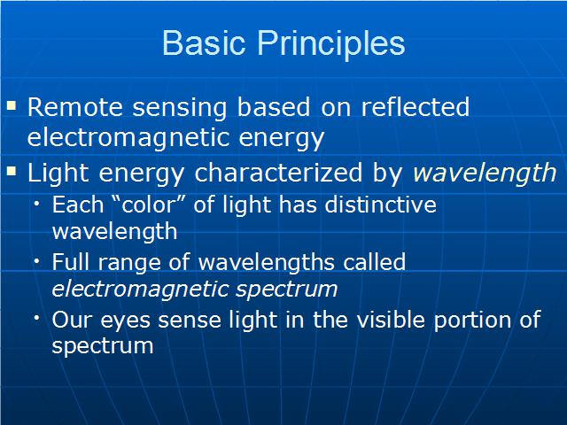

Slide 13
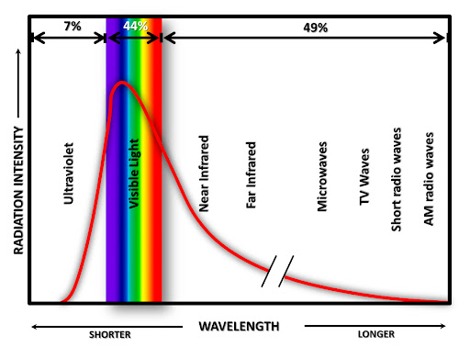
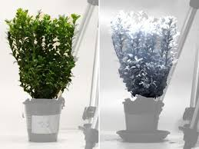

Slide 14
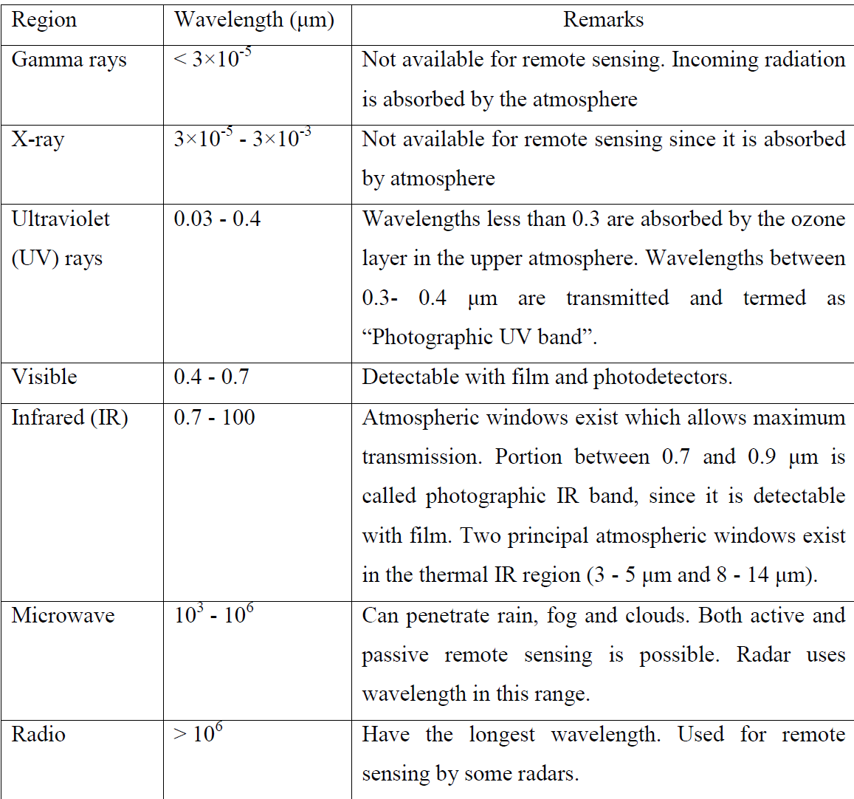

Slide 15
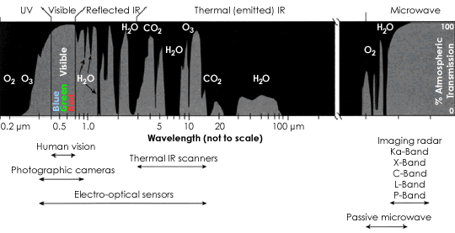
Effects of Atmosphere on the
electromagnetic spectrum: Atmospheric windows for Remote Sensing
Links:
http://www.gisdevelopment.net/tutorials/tuman008.htm
http://earthobservatory.nasa.gov/Library/RemoteSensingAtmosphere/

Slide 16
WHAT are different type of remote sensing?
Classification of Remote sensing:
Based on spectral region:
Optical/IR remote sensing ( 0.4 to 8.0 micometer)
Thermal remote sensing ( 8 to 12 micrometer)
Microwave remote sensing ( .3 to 100 GHz)
The micrometre ( μm) also commonly known as a micron, is unit of length equalling 1×10−6 metre

Slide 17
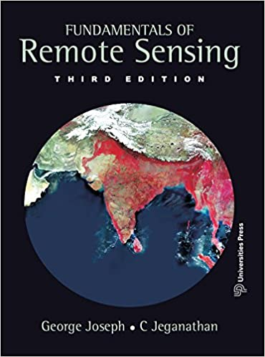
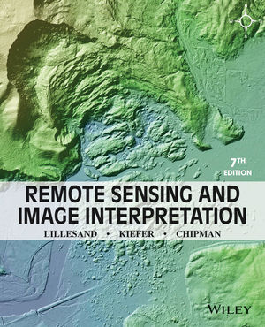
https://www.usna.edu/Users/oceano/pguth/md_help/html/satb8rlf.htm
https://appliedsciences.nasa.gov/join-mission/training/english/arset-fundamentals-remote-sensing
https://www.nrcan.gc.ca/maps-tools-and-publications/satellite-imagery-and-air-photos/tutorial-fundamentals-remote-sensing/9309

Slide 18
Further suggested reading
https://nptel.ac.in/content/storage2/courses/1/05108077/module1/lecture1.pdf http://hillagric.ac.in:999/downloads/gis/notes/4-IntroductiontoRemoteSensing.pdf
Chapter 1: Remote sensing by Campbell and Wyne

Slide 19
Question Bank
1. What is remote sensing?
2. What are three main electromagnetic region of remote sensing.
3. Explain Planck’s law. What is peak wavelength of emitted radiation
from sun and earth.
4. Explain Components of Remote sensing

